Slide 1
Neighborhood walkability and depressive symptoms in black women: A prospective cohort study
Matthew Berger, PhD
APHA Annual Meeting & Expo
November 8, 2017

Slide 2
Presenter Disclosures
  No relations to disclose

Slide 3
Back Story
1 of 3 studies for my Boston University School of Public Health (BUSPH) doctoral dissertation
  Epidemiology
  Neighborhood walkability→ incident diabetes
  Comparing two distinct walkability measures
BUSPH Committee:
  Dr. Lauren Wise, Sc.D. (chair)
  Dr. Patricia Coogan, Sc.D.
  Dr. Laura White, PhD
Defended December 2014, commenced May 2015

Slide 4
Depressive Symptoms
Range from
  Mild, temporary episodes of sadness to
  Major depressive disorder (MDD): psychiatric illness that causes a persistent feeling of sadness and loss of interest; can cause noticeable disruptions in daily life^{[1]}
An estimated 21% of U.S. adults will experience a mood disorder (e.g. MDD) in their lifetime
  10% will do so in a given 12-month period^{[2]}
MDD is 50% more prevalent among women than men^{[2]}
  Black women aged 28-40: higher average depressive symptoms than similarly aged white women and men^{[3]}

Slide 5
Causes of depression?
Underlying genetic, neurologic, early childhood (e.g., trauma) conditions often trigger onset between adolescence and 30s^{[4]}
  More proximate causes may include
    less physical activity^{[5]}
    social isolation^{[5,6]}
The more “walkable” the built environment,
  the higher the rates of physical activity^{[7-11]}
  the higher the social connectivity^{[5]}

Slide 6
Hypothesis
Relative to African-American women who live in the most walkable neighborhoods...

Slide 7
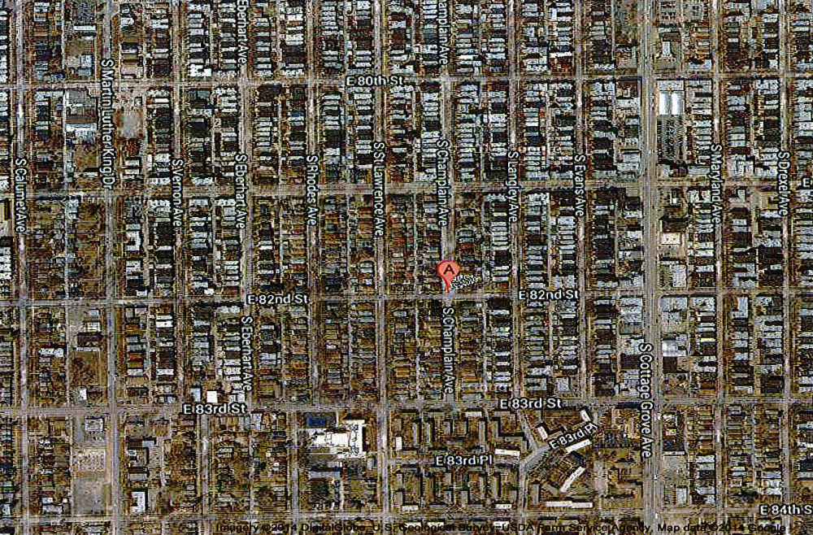
Chicago, IL (Zip Code 60619)

Slide 8
Hypothesis
…African-American women who live in less walkable neighborhoods will have a higher incidence of depressive symptoms.

Slide 9
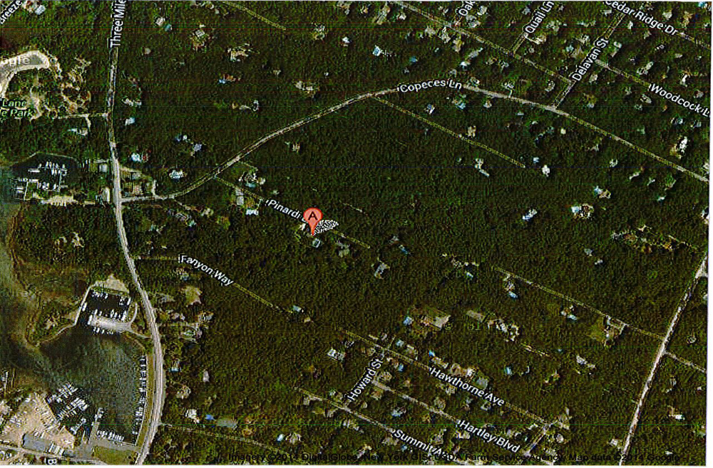
East Hampton, NY (11937-5910)

Slide 10
Cohort:
Black Women’s Health Study (BWHS)
~59,000 black women aged 21-69 recruited 1995^{[12]} via questionnaires to
  Essence subscribers
  Members of Black professional organizations
  Respondent friends and relatives
BWHS participants followed biennially by mailed questionnaire to assess risk factors for variety of diseases
  Follow-up average >80% of original cohort through 2011 questionnaire cycle
Notes:
This is 30% of total BWHS population in 1995
Unused measures:
Ratio of 3-way intersections to all intersections
Number of intersections, total
Population density (# people / acre)
Total length of sidewalks
Total length of road segments
Distance to nearest park (minimum size, 5 acres)
Percent resident
Percent non-resident

Slide 11
Exposure: Neighborhood walkability
  From Coogan, White (inter alia)^{[7,13]} “urban form” measure
    Aerial photography, road network files, transit maps, 2000 U.S. Census
14 neighborhood aspects (“components”) in 0.5-mile road buffer around BWHS participant home addresses in
  Chicago, Los Angeles, NYC Metropolitan Planning Organizations in
  1995 and/or 1997 and/or 1999
  n=20,293
Notes:
net housing density, land use, street interconnectedness, public transit access, major roads, distance to parks, % streets with sidewalk coverage

Slide 12
Neighborhood walkability components
Component | Factor Loadings
Total Length of Sidewalks | 0.91
Ratio 3-way to Intersection Total | -0.80
Number of Intersections | 0.79
Ratio 4-way to Intersection Total | 0.79
Total Length of Bus Routes | 0.76
Population Density | 0.73
Housing Density | 0.69
Intersection Density | 0.63
% Road Segments with Sidewalks | 0.58
Distance to Nearest Public Transit | -0.39
Average Block Size | -0.34
% Residential Land Use | 0.33
Distance to Nearest Park | -0.33
Total Length of Major Roads | 0.03
Notes:
net housing density, land use, street interconnectedness, public transit access, major roads, distance to parks, % streets with sidewalk coverage

Slide 13
How exposure constructed?
Factor analysis ➔ single factor (40% variance)
  Combined 1995, 1997, 1999 addresses for 20,293 BWHS participants
  PROC SCORE (SAS): Mean=0; -3.9 to +3.6 SD
  No a priori categories: cut at midpoints of mean value within five WalkScore® categories (www.walkscore.com)
  2 most walkable categories ➔ single category (small cell sizes in Chicago, LA)
Notes:
net housing density, land use, street interconnectedness, public transit access, major roads, distance to parks, % streets with sidewalk coverage

Slide 14
Neighborhood walkability categories, % study participants
Least (<-1.28) 11%
2nd least (-1.28 - <-0.44) 20%
2nd most (-0.44 - <0.18) 23%
Most (≥0.18) 46%
Notes:
net housing density, land use, street interconnectedness, public transit access, major roads, distance to parks, % streets with sidewalk coverage

Slide 15
Neighborhood walkability by city, SES
69% of Most walkable neighborhoods in NYC; only 9% in LA
Strong inverse relationship with neighborhood socioeconomic status (SES)
  Most walkable neighborhoods: mean SES 1.03 SD lower than Least walkable neighborhoods
  Pearson r=-0.30

Slide 16
Outcome: Center for Epidemiologic Studies-Depression (CES-D) scale
  Current (past week) depressive symptoms^{[14]}
  Sum of 20 questions scored 0,1,2,3
  Range=0-60; higher scores = higher symptom level
  Incorporated into BWHS 1999, 2005
While CES-D does not replace physician diagnosis
  Typical “depression” threshold = 16 or higher
  Other studies^{[15,16]} propose cutting at 25

Slide 17
Analytic cohort/outcome
At baseline (1995): 17,886 women with…
  no diagnosed depression,
  neighborhood walkability score
# with CES-D scores: 12,707 (1999); 9,983 (2005)
Outcome=cut-points of 16, 25
Exposure, covariates fixed at baseline

Slide 18
Statistical methods
Mixed effects log-binomial regression used to estimate risk ratios
  Up to two possibly-correlated outcomes
  Complete case analysis (<1% missing)
  Sensitivity analyses
  SAS 9.3

Slide 19
Assessing confounding
Potential (available) confounders from literature review assessed via
  Directed acyclic graph
  Epidemiological criteria,
    vary by exposure,
    outcome risk factor in unexposed,
    not on causal pathway
  Change in estimated RR
Only neighborhood socioeconomic status (SES) changed RR≥10%
  Age, marital status changed RR≥5%

Slide 20
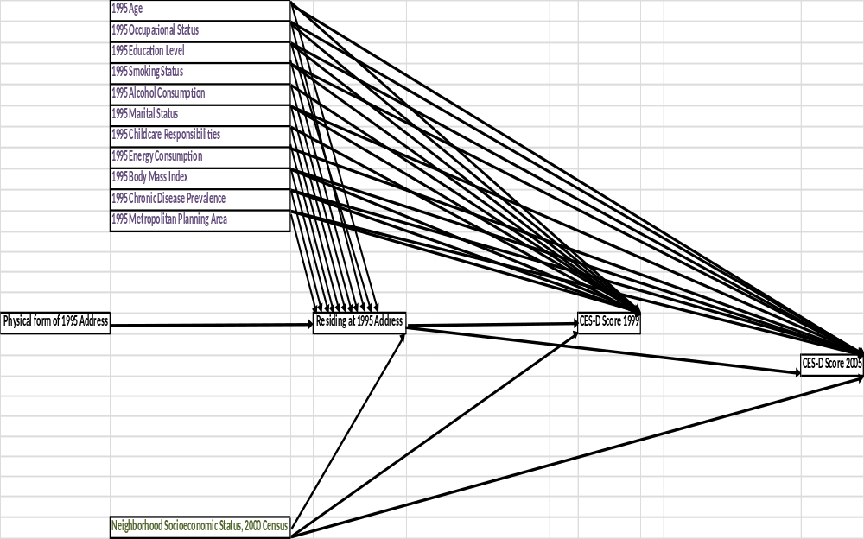
Directed Acyclic Graph
Notes:
net housing density, land use, street interconnectedness, public transit access, major roads, distance to parks, % streets with sidewalk coverage

Slide 21
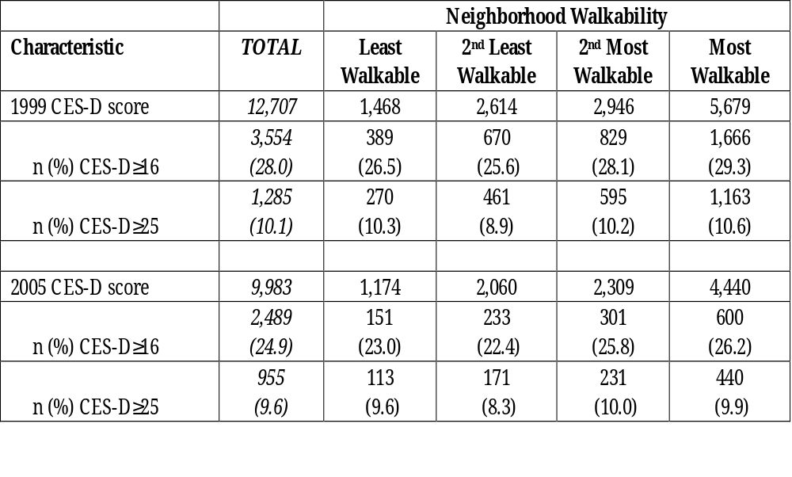
CES-D categories by Neighborhood Walkability and Year
1 in 4 women had CES-D≥16, and 1 in 10 had CES-D≥25

Slide 22
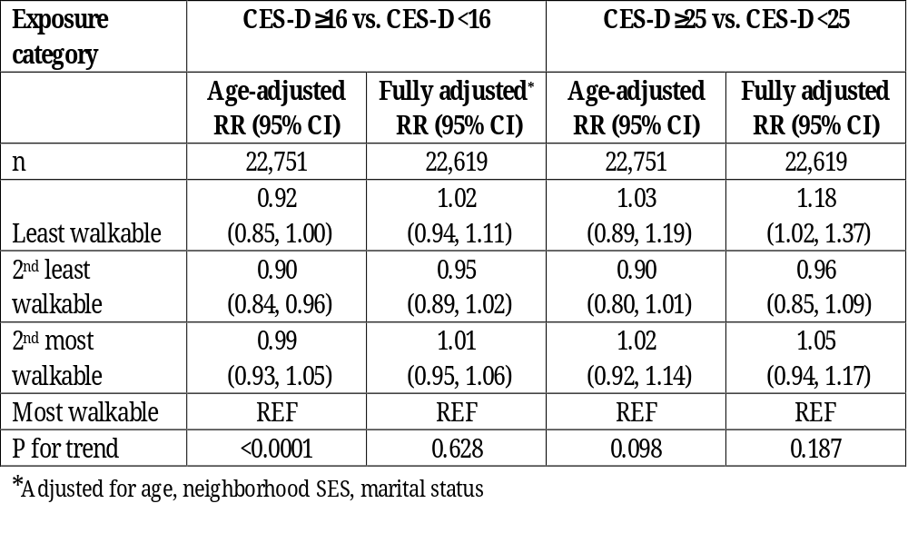
Neighborhood Walkability and Depressive Symptoms

Slide 23
Neighborhood Walkability and Depressive Symptoms
Near-null association even after adjustment for age, SES, marital status

Slide 24
Neighborhood Walkability and Depressive Symptoms
But 18% increased risk for Least walkable

Slide 25
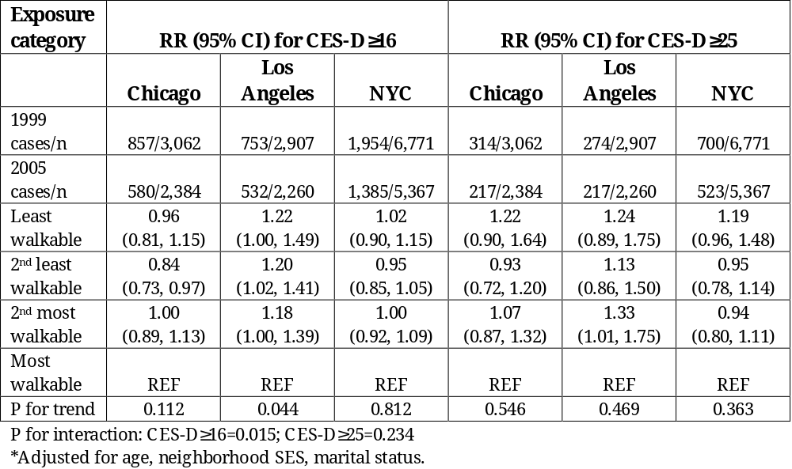
Neighborhood Walkability and Depressive Symptoms: By City
Strongest results in LA:
18-22% increased risk (≥16)
13-33% increased risk (≥25)

Slide 26
Neighborhood Walkability and Depressive Symptoms: By City

Slide 27
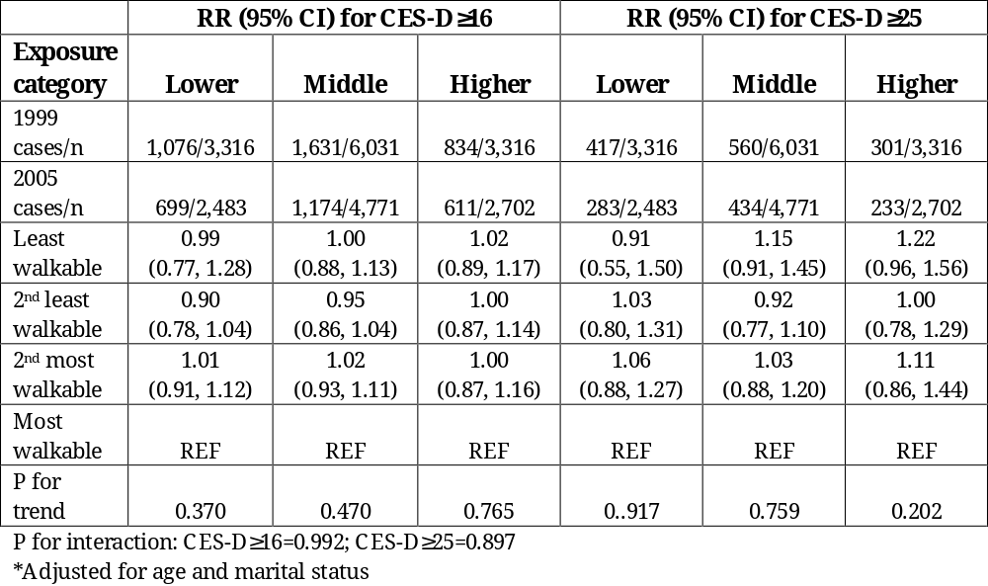
Neighborhood Walkability and Depressive Symptoms: By Neighborhood SES
No discernible differences

Slide 28
Summary
Residing in Least walkable neighborhood (vs. Most walkable) associated with 18% increased risk of CES-D≥25 in 1999/2005, adjusting for age, neighborhood SES, marital status
Increase (slightly) higher for…
  LA residents
  Women engaging in no vigorous exercise
  Women spending <1 hour/day riding in car/bus
Decreased risk of CES-D≥16/25 for 2nd least walkable neighborhood Chicago residents

Slide 29
Strengths
Prospective design ➔ clear temporal association
Multiple measurements ➔ More incident “cases”
Large study size ➔ increased precision of RR estimates
Access to many identified potential confounders
Wide range of suburban and urban areas = higher confidence in findings
Plus, black women understudied with respect to health impact of built environment

Slide 30
Limitations
Insufficient control of confounding?
  Most likely attenuate modest associations
Non-dependent misclassification?
  No address data prior to 1995 or exposure data past 1999
  Inaccurate measurement of walkability
    Proper component, properly combined?
    Continuous→discrete=differential misclassification?
    Insufficient risk differences across categories?
  Self-reported outcome
Time?
  Induction, latency periods relative to neighborhood walkability (1999, 2005 too far in future?)
  Inverse probability of treatment weighting across strata of neighborhood SES suggests no LTFU bias

Slide 31
Recommendations?
Further study?
  More exurban/rural locales (wider exposure gap)
  Associations with each walkability component
  Alternate ways to combine walkability components?
Policy?
  Neighborhoods with more opportunities for walking may otherwise be less desirable places to live
  Challenge: design/create neighborhoods which are
    conducive to walking and
    highly desirable places to live,
    while encouraging full advantage of current opportunities

Slide 32
  Bibliography
http://www.mayoclinic.com/health/clinical-depression/AN01057 Accessed September 1, 2012.
Kessler RC, Chiu WT, Demler O, Walters EE. Prevalence, severity, and comorbidity of twelve-month DSM-IV disorders in the National Comorbidity Survey Replication (NCS-R). Archives of General Psychiatry, 2005 62(6):617-27.
Henderson C, Diez Roux AV, Jacobs DR, et al. 2005. Neighbourhood characteristics, individual level socioeconomic factors, and depressive symptoms in young adults: the CARDIA study. J Epidemiol Community Health 59:322-28.
http://www.mayoclinic.com/health/depression/DS00175/DSECTION=causes Accessed September 1, 2012.
Wise LA, Adams-Campbell LL, Palmer JR, et al. 2006. Leisure time physical activity in relation to depressive symptoms in the Black Women’s Health Study. Ann Behav Med 32(1):68-76.
Miles R, Coutts C and Mohamadi A. 2011. Neighborhood urban form, social environment, and depression. J Urban Health 89(1).
Coogan PF, White LF, Adler TJ, et al. Prospective study of urban form and physical activity in the Black Women’s Health Study. Am J Epidemiol 2009; 170(9):1105-17.
Frank LD, Andresen MA, Schmid TL. Obesity relationships with community design, physical activity, and time spent in cars. Am J Prev Med 2004;27(2):87-96.
Ewing R, Schmid T, Killingsworth R et al. 2003. Relationship between urban sprawl and physical activity, obesity, and morbidity. Am J Health Promot 18(1):47-57.
Carlson C, Aytur S, Gardner K, et al. 2012 Complexity in Built Environment, Health, and Destination Walking: A Neighborhood-Scale Analysis. Journal of Urban Health 89(2):270-84.
Berrigan D, Pickle LW and Dill J. 2010. Associations between street connectivity and active transportation. Intl J Health Geographics 9:20. The electronic version of this article is the complete one and can be found online at: http://www.ij-healthgeographics.com/content/9/1/20.

Slide 33
  Bibliography, cont.
Rosenberg L, Adams-Campbell LL, Palmer JR. 1995. The Black Women’s Health Study: A follow-up study for causes and preventions of illness. J Am Wom Med Assoc 50:56-58.
Coogan PF, White LF, Evans SR, et al. Longitudinal assessment of urban form and weight gain in African-American women. Am J Prev Med 2011;40(4):411-418.
Radloff LS. 1977. The CES-D scale: A self-report depression scale for research in the general population. Applied Psychological Measurement. 1(2):85-201.
Harlow BL, Cohen LS, Otto MW, et al. 1999. Prevalence and predictors of depressive symptoms in older premenopausal women: The Harvard Study of Moods and Cycles. Arch Gen Psychiatry. 56(5):418-24.
Craig TJ, van Natta PA. 1976. Recognition of depressed effect in hospitalized psychiatric patients: staff and patient perceptions. Dis Nerv Syst. 37:561-66.

Slide 34
Questions?

